Slide 1
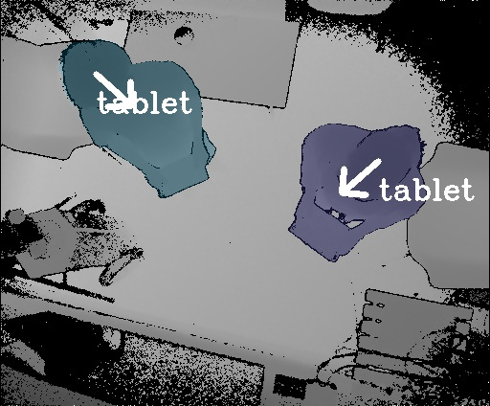
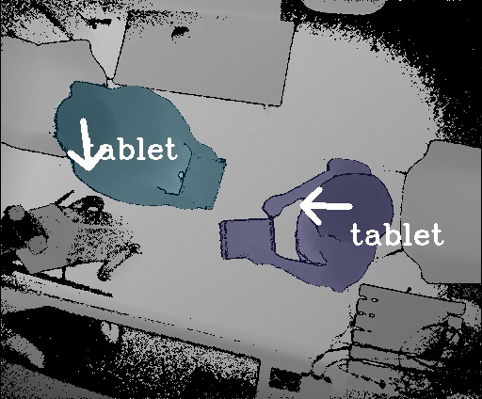
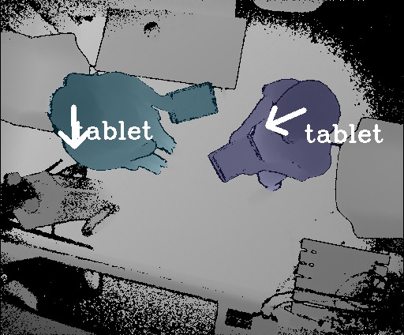
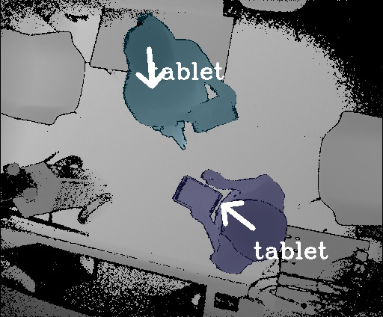
EAGLESENSE
Tracking People and Devices in Interactive Spaces using
Real-Time Top-View Depth-Sensing
Chi-Jui Wu¹, Steven Houben², and Nicolai Marquardt¹
1 University College London
2 Lancaster University
Notes:
Hi, my name is Chi-Jui Wu, …

Slide 2
EAGLESENSE
Tracking People and Devices in Interactive Spaces using
Real-Time Top-View Depth-Sensing
Chi-Jui Wu¹, Steven Houben², and Nicolai Marquardt¹
(Charles)
1 University College London
2 Lancaster University
Notes:
Or just Charles.
I am here to present our paper, “EagleSense: Tracking People and Devices in Interactive Spaces using Real-Time Top-View Depth-Sensing.”
This project was done in in collaboration with Steven Houben and Nicolai Marquardt, while I was a Master’s student at University College London.

Slide 3
We interact with other people through device ecologies
Notes:
During everyday activities, we interact with many other people through computing device ecologies and non-digital artefacts.

Slide 4
in different form factors and contexts
Notes:
In particular, these device ecologies consist of a variety of form factors and are used in different contexts, for example, in small-group collaboration.

Slide 5
Proxemic Interaction
Notes:
Further, smart devices increasingly leverage proxemic information about our surrounding environment, such as the location of people and devices.

Slide 6
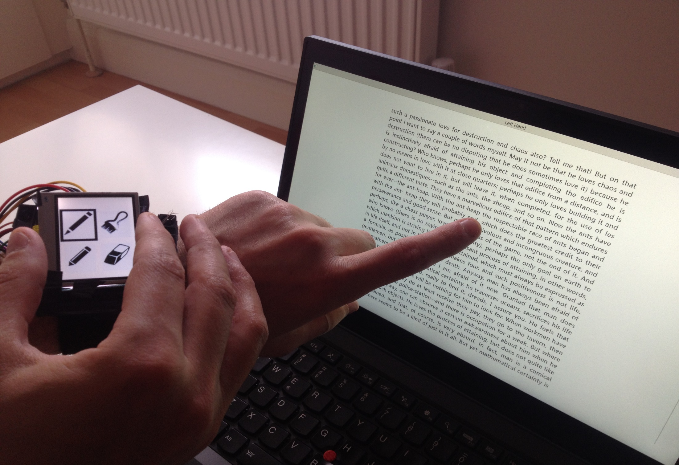
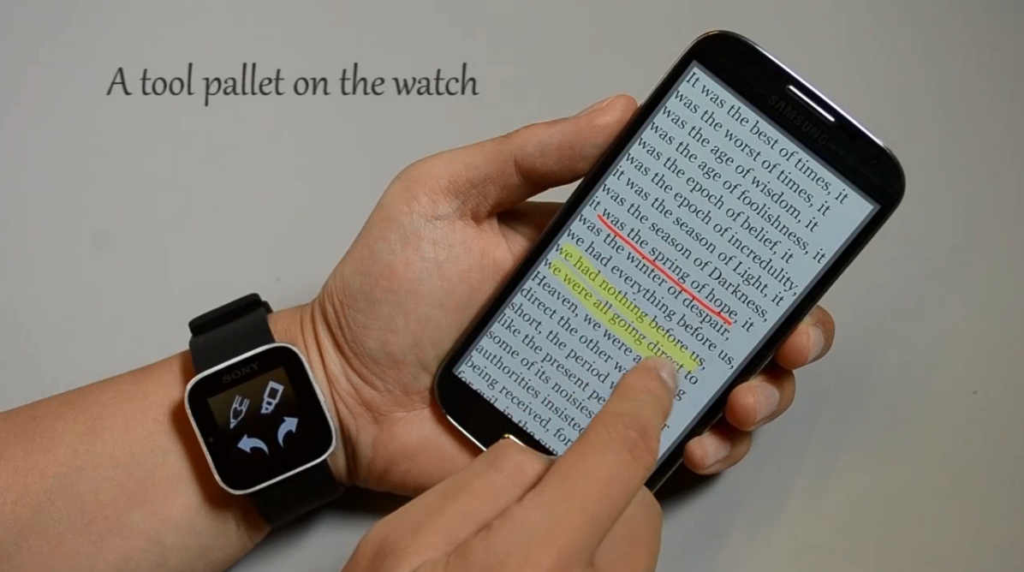
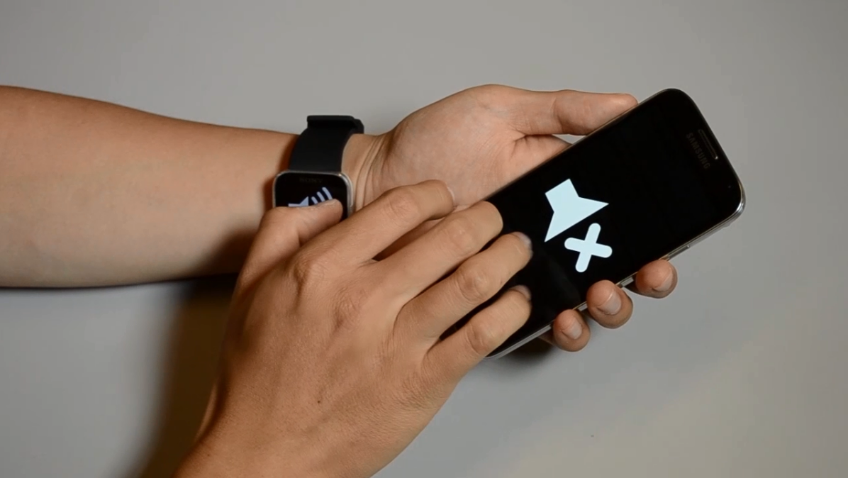
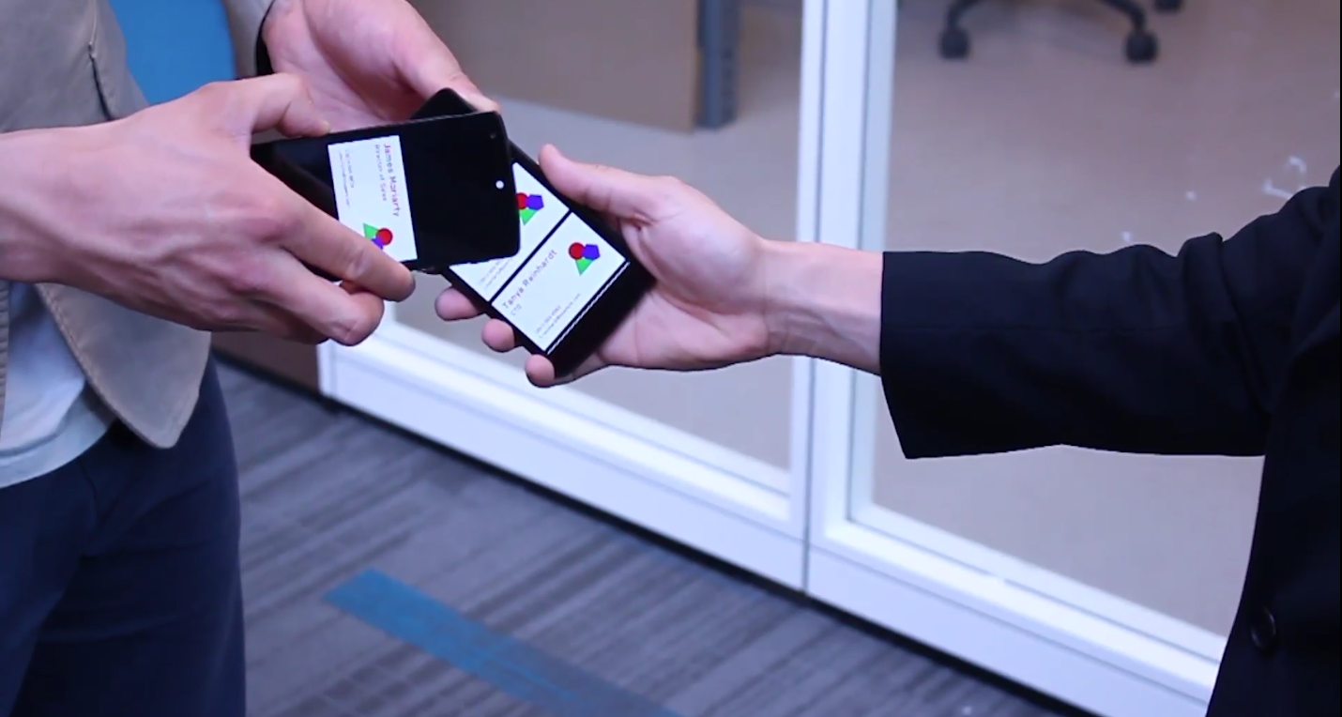
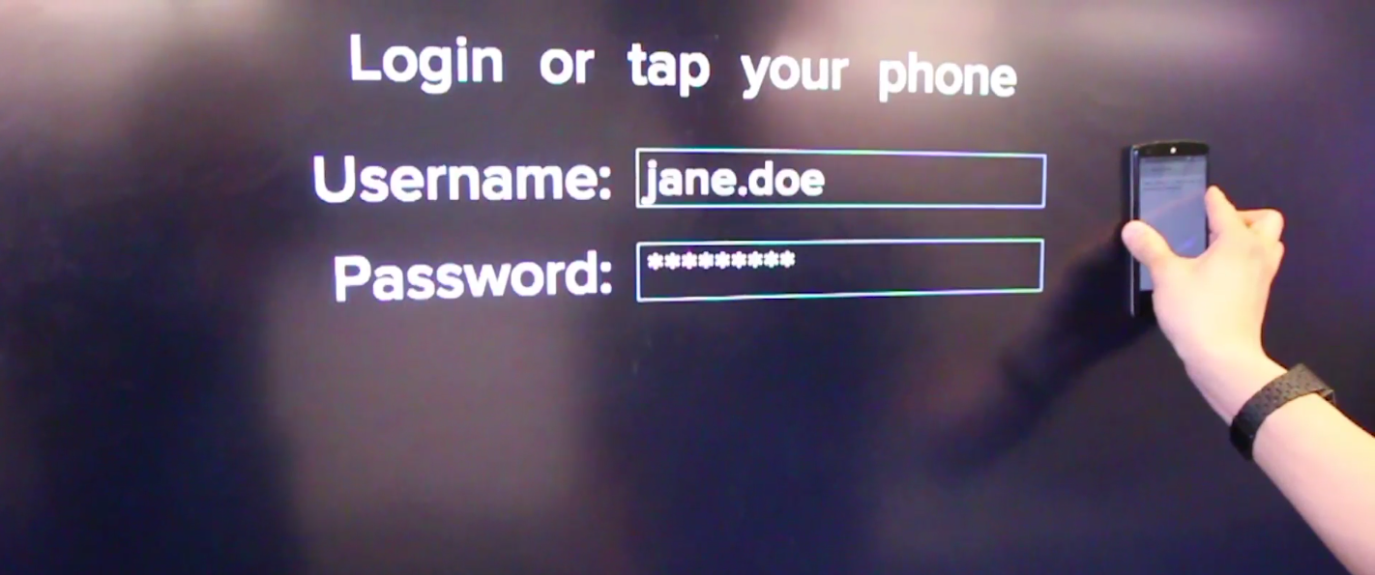
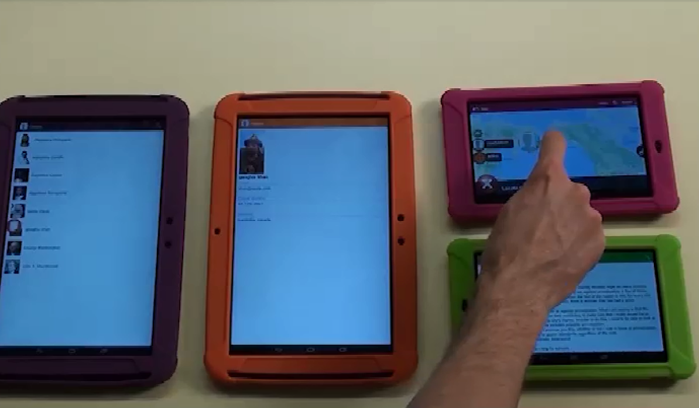
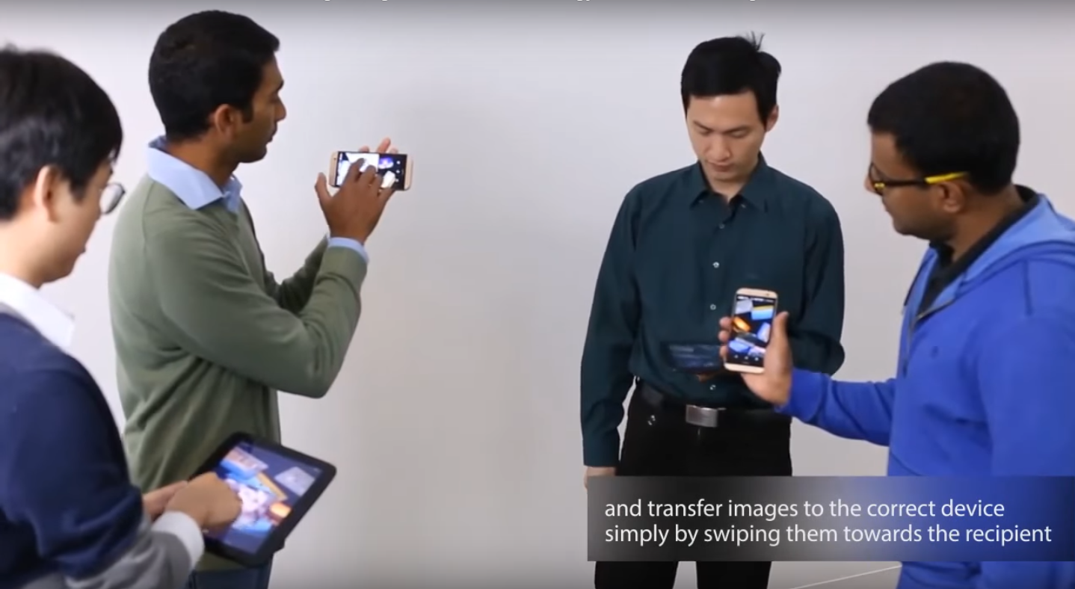
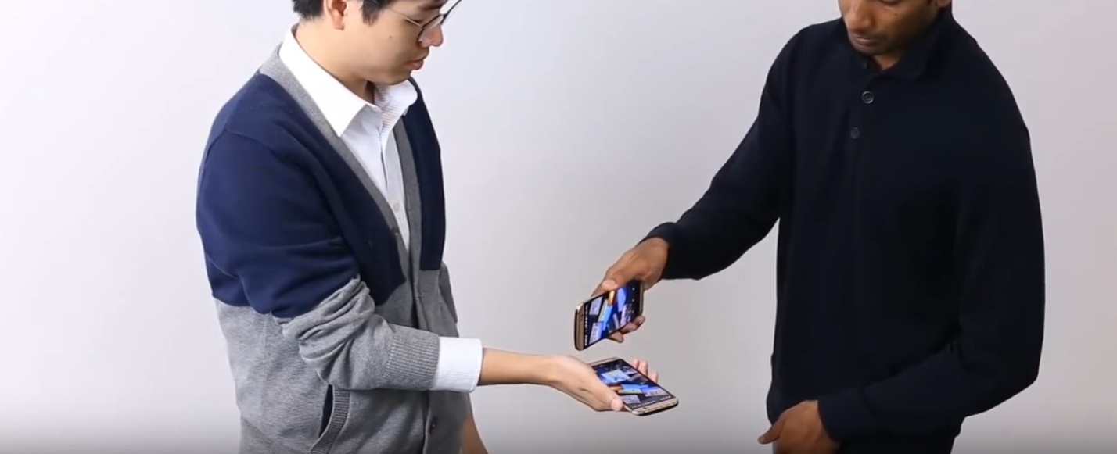
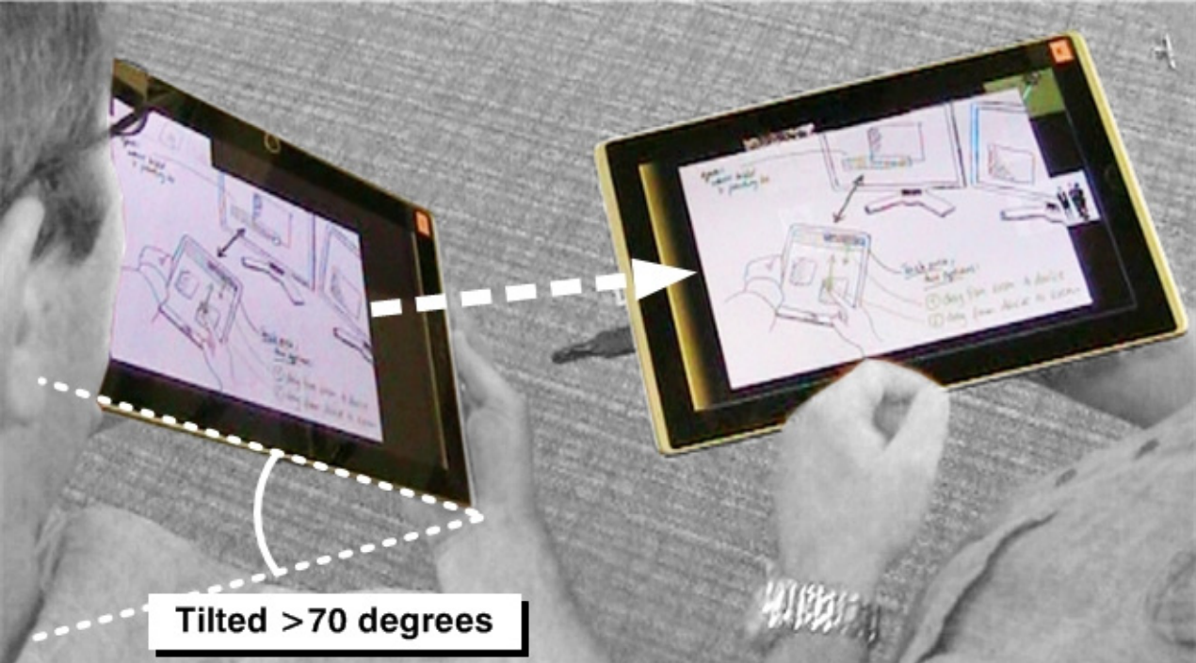
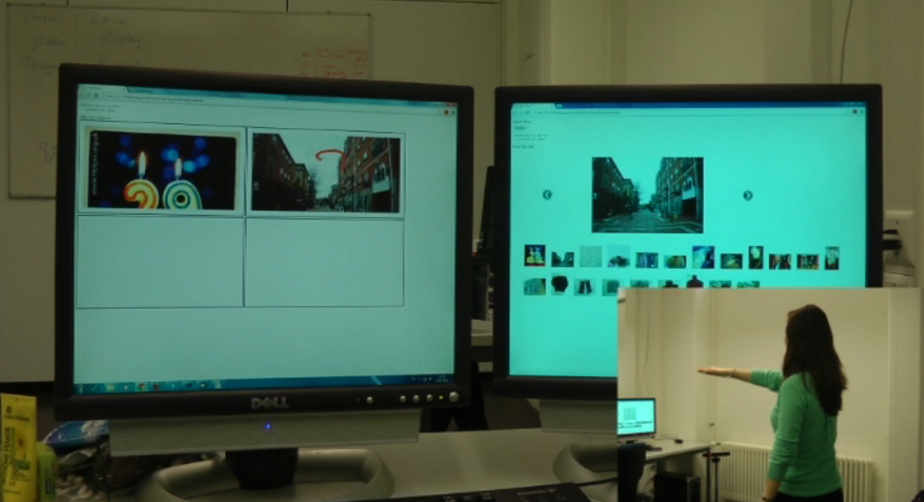
cross-device interaction techniques
Notes:
And over the past few years, an array of cross-device interaction techniques have been proposed to support these kinds of device ecologies and interactive spaces.

Slide 7
Towards Ad Hoc Cross-Device Interaction
Single-User
Single-Device
Notes:
The old computing paradigm was about a single user interacting with a single device …

Slide 8
Towards Ad Hoc Cross-Device Interaction
Single-User
Single-Device
Multi-Users
Multi-Devices
Notes:
But we are really interested in designing new ad-hoc interactive spaces and cross-device interactions that scale to many users and devices in the wild.

Slide 9
We need a supporting infrastructure for
ad hoc cross-device interaction
Notes:
However, to build such applications, developers need a supporting infrastructure that ….

Slide 10
We need a supporting infrastructure for
ad hoc cross-device interaction
human activities
Notes:
… senses not only the activities of the users but also …

Slide 11
We need a supporting infrastructure for
ad hoc cross-device interaction
human activities
devices and objects
Notes:
… the physical location of devices and objects in use.

Slide 12
HCI Tools for Tracking People and Devices
Group-Together (people and devices) [Marquardt et al., UIST’12]
DT-DT (people) [Hu et al., ITS’14]
HuddleLamp (hands and devices) [Rädle et al., ITS’14]
Tracko (devices) [Jin et al., UIST’15]
ID-Match (people) [Li et al., CHI’16]
Notes:
In HCI research, several work have developed different tools for tracking people and devices to support interaction techniques or interactive systems.

Slide 13
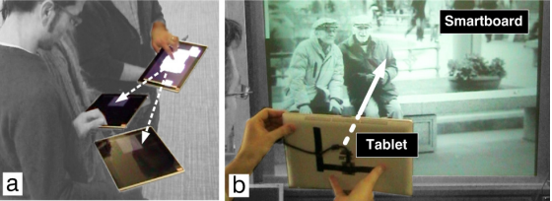
HCI Tools for Tracking People and Devices
Group-Together (people and devices) [Marquardt et al., UIST’12]
Notes:
In our previous work…
Group-Together is the first proof-of-concept system to detect f-formations of people through top-view depth-sensing cameras, as well as micro-mobility of devices through external radio modules and accelerometers on devices.
It contributes the design exploration of collocated cross-device interaction techniques that leverage the proxemics of people and devices

Slide 14
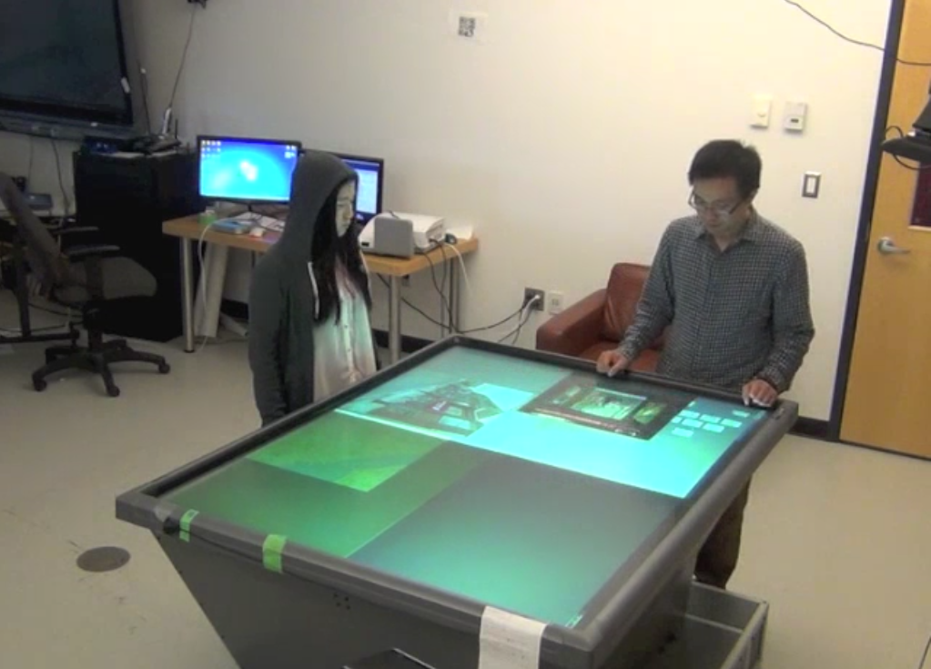
HCI Tools for Tracking People and Devices
DT-DT (people)
[Hu et al., ITS’14]
Notes:
DT-DT is a demonstrator system that tracks human position and gestures, also using a top-view depth-sensing camera.
And It conducts a preliminary system evaluation, such as tracking users during tabletop interaction.

Slide 15
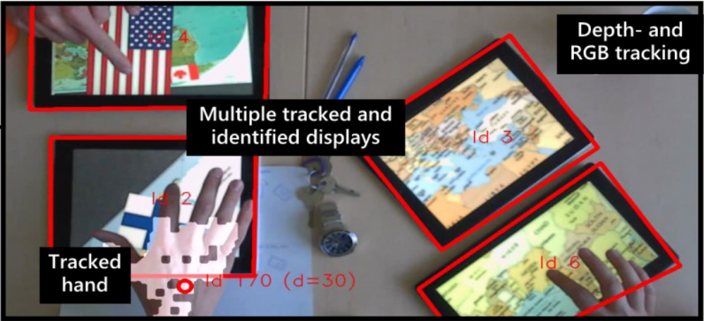
HCI Tools for Tracking People and Devices
HuddleLamp (hands and devices) [Rädle et al., ITS’14]
Notes:
In the research of tracking mobile devices, HuddleLamp tracks the location of tablets on a fixed table, as well as hand positions above these devices, using top-view depth-RGB hybrid sensing.
It enables cross-device interaction on ad hoc combinations of tablets.

Slide 16
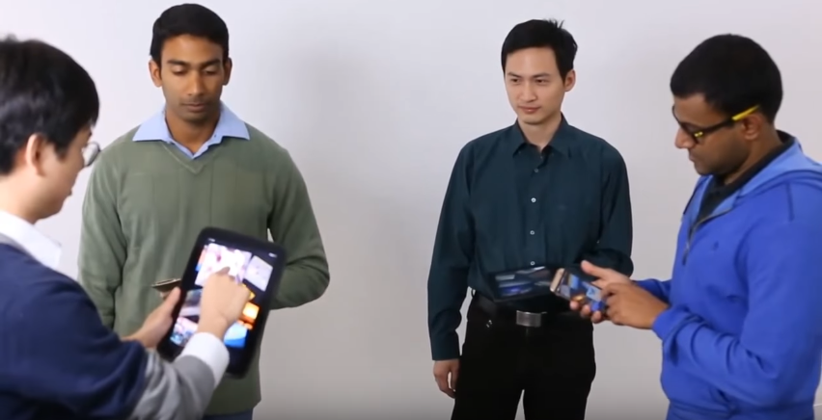
HCI Tools for Tracking People and Devices
Tracko (devices)
[Jin et al., UIST’15]
Notes:
To address the limitations of cross-device interaction in a fixed space, Tracko tracks the position of ad hoc mobile devices in small groups using Bluetooth low energy and inaudible stereo sounds.

Slide 17
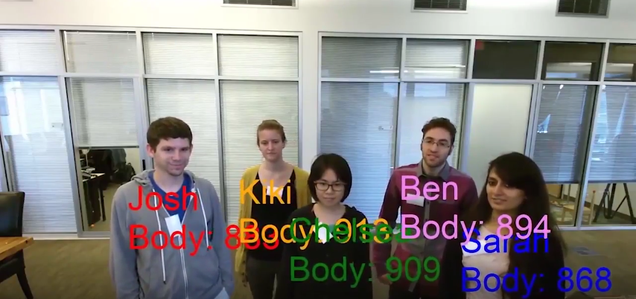
HCI Tools for Tracking People and Devices
ID-Match (people) [Li et al., CHI’16]
Notes:
And last year at CHI, ID-Match recognizes people in groups and tracks them through occlusion as the basis for human-robot interaction, by combining depth and RFID sensing.

Slide 18
Notes:
These prior work demonstrate the feasibility of tracking people and devices, yet

Slide 19
Tracking people, activities, and devices
altogether in ad hoc interactive spaces
remains a challenging problem
Notes:
tracking people, activities, and devices altogether in ad hoc interactive spaces remains a challenging problem.

Slide 20
EagleSense
Notes:
To address this research gap, we developed EagleSense, which enables rapid prototyping of ad-hoc cross-device applications that leverage the sensing of both people and devices.

Slide 21
TOP-VIEW
DEPTH-SENSING CAMERA
Notes:
EagleSense consists of a single depth-sensing camera positioned at a top-down angle, sensing the space through the bird’s eye view.
Earlier work such as Group Together and DT-DT showed that positioning the camera at a top-down angle, compared to using the conventional front-facing setup, can yield a much larger effective tracking area and avoid occlusion problems.

Slide 22
TOP-VIEW
DEPTH-SENSING CAMERA
TRACKED POSITION, ORIENTATION,
POSTURES AND ACTIVITES OF PEOPLE
Notes:
EagleSense tracks, in real-time, the position, orientation, postures and activities of people in the space.

Slide 23
TOP-VIEW
DEPTH-SENSING CAMERA
SEGMENTED
DEPTH SILHOUETTES
Pointing
Tablet
TRACKED POSITION, ORIENTATION,
POSTURES AND ACTIVITES OF PEOPLE
Standing
Notes:
It senses these high-level events primarily from the segmented human silhouette, which I will describe shortly.

Slide 24
Posture recognition
Mobile devices recognition
Real-time tracking data
Configurability for tracking
Walk-up-and-use applications
Notes:
Overall, EagleSense implements five key functionalities:

Slide 25
Posture recognition
Mobile devices recognition
Real-time tracking data
Configurability for tracking
Walk-up-and-use applications
Notes:
First, tracking of people – their position, orientation, and posture

Slide 26
Posture recognition
Mobile devices recognition
Real-time tracking data
Configurability for tracking
Walk-up-and-use applications
Notes:
Second, tracking of unmodified devices of different form factors in use

Slide 27
Posture recognition
Mobile devices recognition
Real-time tracking data
Configurability for tracking
Walk-up-and-use applications
Notes:
At real-time framerates and providing access to the tracking data

Slide 28
Posture recognition
Mobile devices recognition
Real-time tracking data
Configurability for tracking
Walk-up-and-use applications
Notes:
Forth, configurability for the tracking system, including training new recognition models

Slide 29
Posture recognition
Mobile devices recognition
Real-time tracking data
Configurability for tracking
Walk-up-and-use applications
Notes:
And at last, support for building new walk-up-and-use cross-device applications

Slide 30
Notes:
Here’s a system demonstration video. On the left is the depth stream, in the middle are the infrared stream and an external web cam feed, lastly, on the right is EagleSense’s visualization of the space.
EagleSense recognizes postures and activities … (next slide – auto play)

Slide 31
Notes:
(auto-play)
such as standing, sitting, pointing, using mobile devices including phones and tablets, or reading paper documents, all at 30 frames per second.

Slide 32
EagleSense Implementation
Phase A
Phase B
Top-View Depth-Sensing Tracking
Posture and Activity Recognition
Notes:
I will now describe EagleSense’s technical implementation, which consists of two phases.

Slide 33
EagleSense Implementation
Phase A
Phase B
Top-View
Depth-Sensing
Tracking
Posture and Activity Recognition
Notes:
Phase A is : top-view depth-sensing tracking.
In this phase, each person in the space is individually tracked.

Slide 34
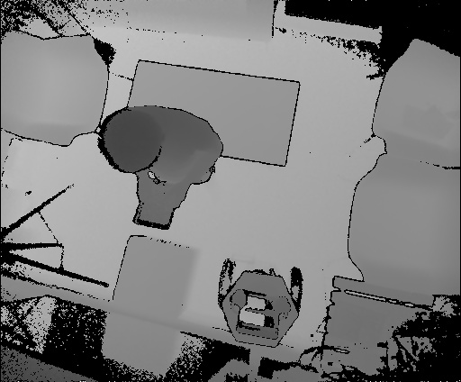
Phase A: Top-View Depth-Sensing Tracking
Depth Silhouette
Notes:
First, we obtain the 8-bit depth and infrared streams from a Kinect v2 sensor.

Slide 35
Phase A: Top-View Depth-Sensing Tracking
Depth Silhouette
Notes:
From the depth map, we use Gaussian Mixture Models to extract the foreground and each person’s depth silhouette (/silo͞oˈet/).

Slide 36
Phase A: Top-View Depth-Sensing Tracking
Depth Silhouette
Standing
Sitting
Pointing
Phone
Tablet
Paper
Notes:
Most importantly, we downsample the silhouettes (/silo͞oˈet/) to 32 by 32 pixels to enable real-time tracking.

Slide 37
Phase A: Top-View Depth-Sensing Tracking
Infrared Silhouette
Notes:
Similarly, we extract each person’s infrared silhouette (/silo͞oˈet/) from the infrared map and apply a binary threshold, which now shows the low infrared pixels in white.

Slide 38
Phase A: Top-View Depth-Sensing Tracking
Infrared Silhouette
Standing
Sitting
Pointing
Phone
Tablet
Paper
Notes:
From these infrared silhouettes, we can already see that mobile devices such as phones and tablets give more low infrared reflectance at the device location.

Slide 39
Phase A: Top-View Depth-Sensing Tracking
Depth Segmentation
Notes:
Afterwards, we segment the depth silhouette (/silo͞oˈet/) into …

Slide 40
Phase A: Top-View Depth-Sensing Tracking
Depth Segmentation
Notes:
… three layers using K-Means Clustering for activity recognition in Phase B.
Usually, the first layer is the head, the second layer the shoulder, and the third layer the arms and body …

Slide 41
Phase A: Top-View Depth-Sensing Tracking
Depth Segmentation
Notes:
… We also track the head orientation by taking the major axis of the head-fitted ellipse.

Slide 42
Phase A: Top-View Depth-Sensing Tracking
Depth Segmentation
Standing
Sitting
Pointing
Phone
Tablet
Paper
Notes:
The segmented depth silhouette is the basis for posture and activity recognition …

Slide 43
EagleSense Implementation
Phase A
Phase B
Posture and Activity Recognition
Notes:
Which is Phase B of the EagleSense pipeline

Slide 44
Phase B: Posture and Activity Recognition
Depth Features
Notes:
Inspired by Computer Vision literature on activity recognition from depth images, we engineered features from the three-layer segmentation that was created at the end of Phase A.

Slide 45
Phase B: Posture and Activity Recognition
Depth Features
Standing
Sitting
Pointing
Phone
Tablet
Paper
Notes:
Primarily, we use two extreme points at each layer to calculate features such as layer maximal distances and areas, intra- and inter-layer position vectors.
Please refer to our paper for more details on the feature engineering process.
-----------------------------------------
*CV literature: pairwise joints differences, joints orientations, surface normals, depth occupancy patterns, and histograms composed of these features.
*EagleSense paper: layer areas, layer contour counts, layer maximal distances and areas, intra-layer positions, inter-layer positions, body extremities (count), infrared of devices

Slide 46
Phase B: Posture and Activity Recognition
Infrared of Devices
Notes:
To recognize devices from the depth and infrared silhouettes, we follow a similar approach from the HuddleLamp paper.

Slide 47
Phase B: Posture and Activity Recognition
Infrared of Devices
Notes:
We extract 5 convexity defects from the silhouette outside of the head layer …

Slide 48
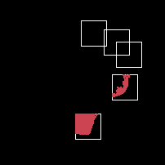
Phase B: Posture and Activity Recognition
Infrared of Devices
Notes:
… and calculate the area of low infrared pixels in these regions, which potentially map to the location of mobile devices.

Slide 49
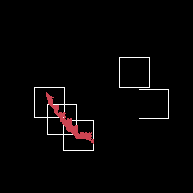
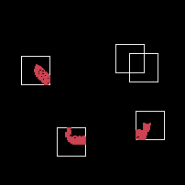
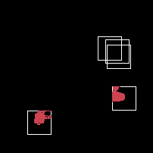
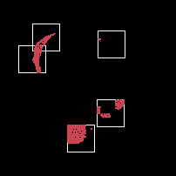
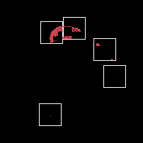
Phase B: Posture and Activity Recognition
Infrared of Devices
Standing
Sitting
Pointing
Phone
Tablet
Paper
Notes:
We use these features to recognize the type of devices or objects in use, and we hypothesized that the larger the device the greater the amount of low infrared reflectance from such device.

Slide 50
Phase B: Posture and Activity Recognition
Real-Time Recognition with XGBoost
EagleSense: “Using tablet”
Notes:
Lastly, we employ parallel computation with the gradient boosting trees system XGBoost for real-time posture and activity recognition from single depth and infrared images.

Slide 51
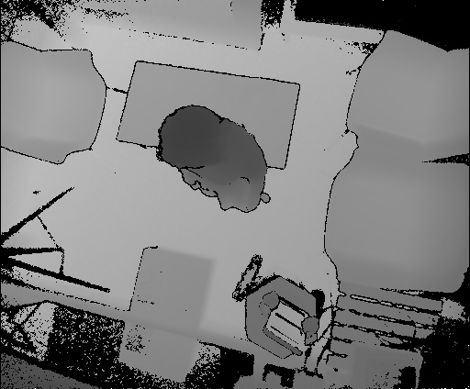
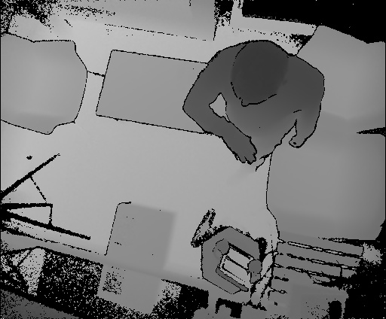
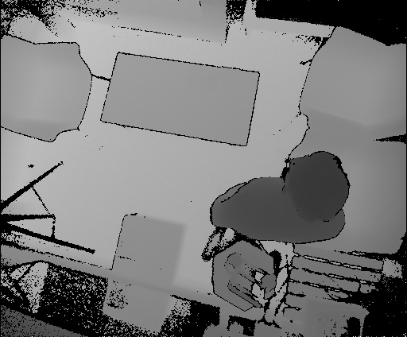
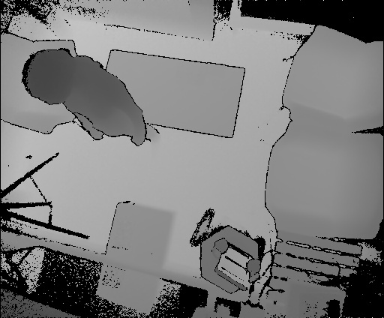
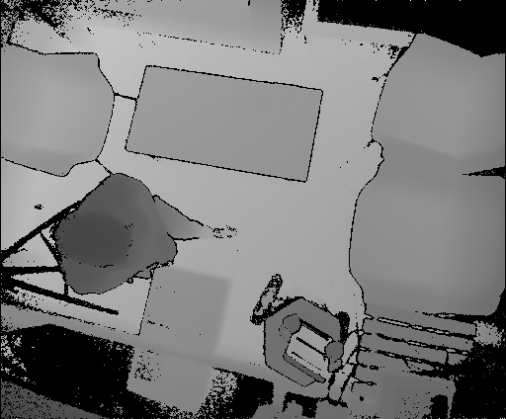
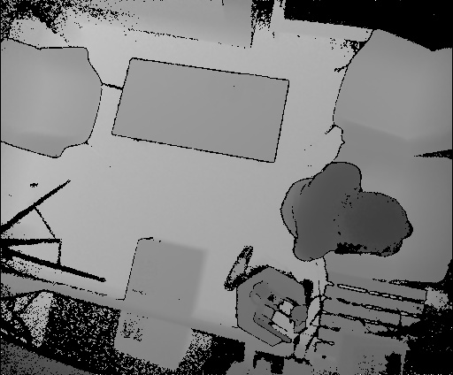
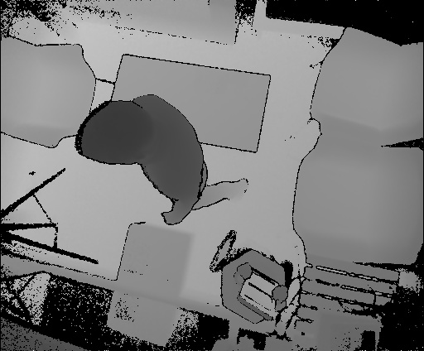
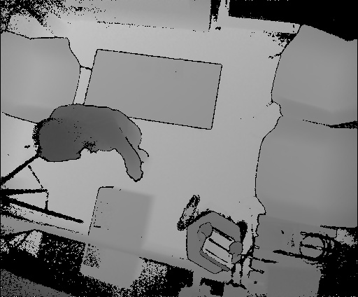
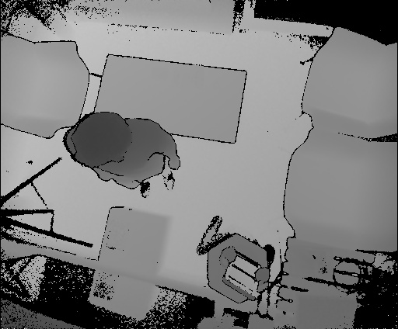
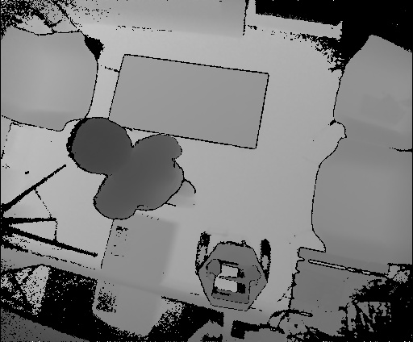
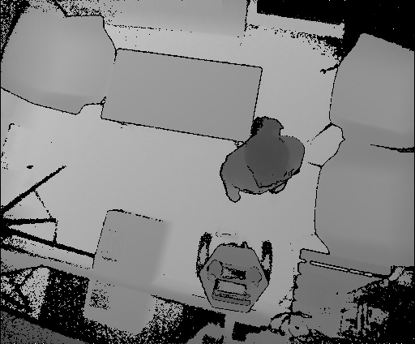
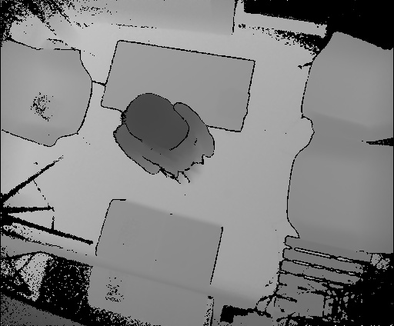
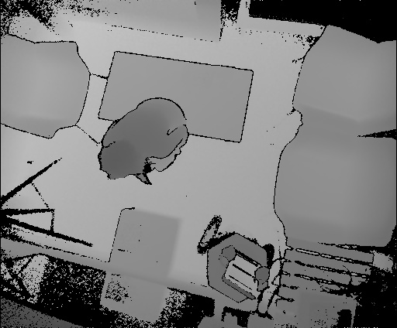
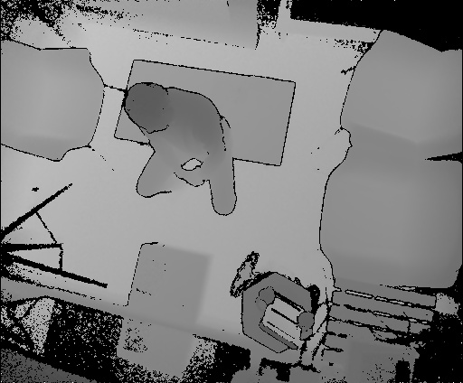
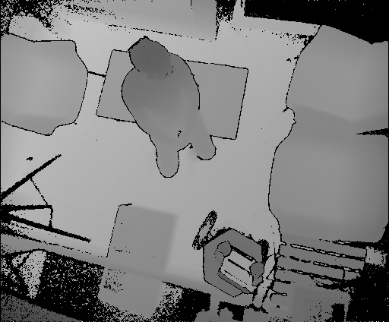
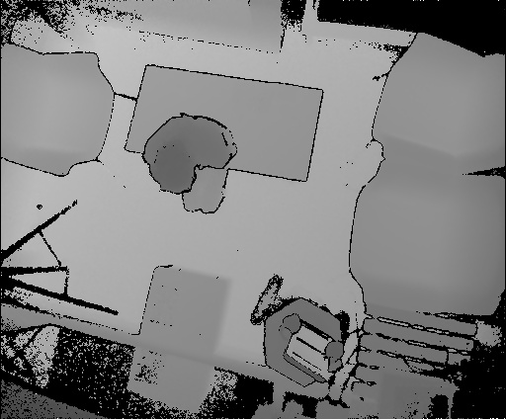
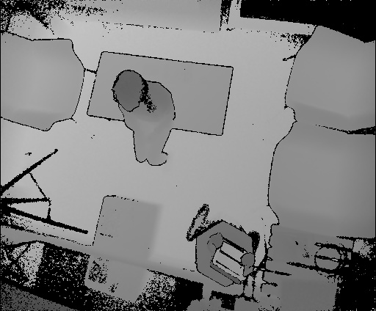
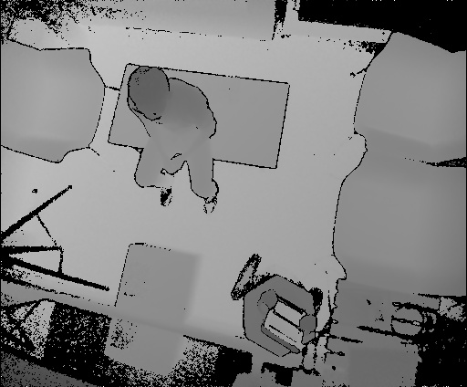
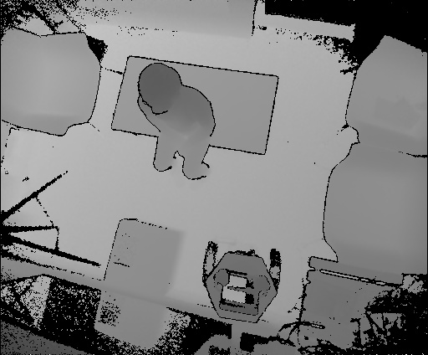
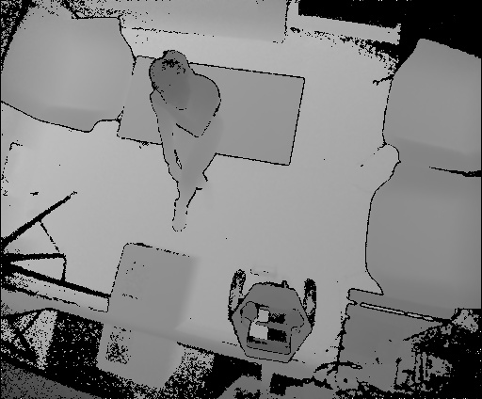
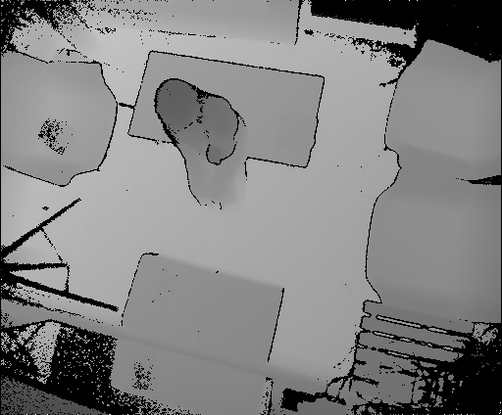
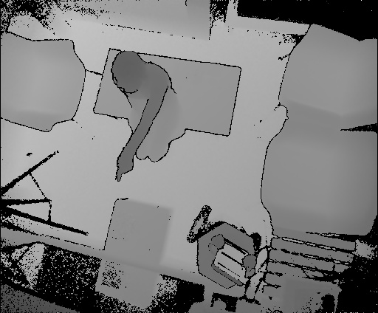
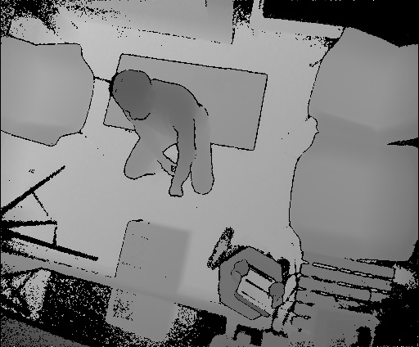
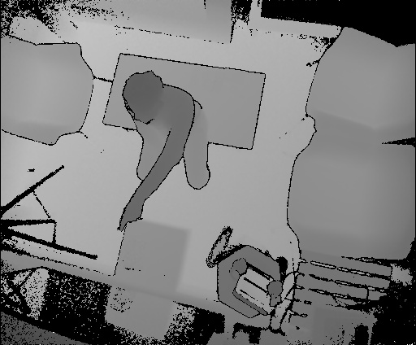
Evaluation
Standing, Sitting, Pointing, Phone, Tablet, Paper
Notes:
To evaluate EagleSense’s real-time recognition accuracy, we ran a study consisting of twelve participants, where we asked each of them to perform tasks involving these six different postures and activities for six minutes.
The participants used their own mobile phones but used the same tablet that was provided by the study instructor.

Slide 52
cross-subject test
Notes:
We followed the same cross-subject testing procedure in related activity recognition literature.
In this test, the dataset was divided equally into halves by participant, into the training and testing sets.
The confusion matrix shows the recognition accuracy, and all but the “using phone” category scored highly at over 90% accuracy.

Slide 53
cross-subject test (all combinations)
Notes:
We also ran the same test on all cross-subject combinations and obtained similar results.
The strength of EagleSense is that the recognition accuracy is very good for the most parts, but it’s less robust at recognizing phones and tablets in free motion, which we really want for ad hoc interactive spaces, where people can either bring the devices or pick up nearby devices and are immediately tracked.

Slide 54
Notes:
Here is another figure of the recognition accuracy. The blue columns are the result when infrared features are included, and orange columns are the results when they aren’t included.
On the x-axis are the different classification classes
On the y-axis is the recognition accuracy.
It really shows the EagleSense strength at recognizing human postures in real-time.

Slide 55
Notes:
We found that it’s difficult to recognize mobile phones in ad-hoc interactive spaces by using the amount of low infrared reflectance.
In the “using phone” category, there was only a small increase in accuracy – at about 10% increase compared to that of “using tablet”’ at 33% – when our proposed infrared features are included.
This was because that mobile phones have much smaller display and frame sizes compared to tablets, hence smaller areas of low infrared reflectance, as well as various holding orientations and usage patterns from different participants in the dataset.

Slide 56
Notes:
With EagleSense, developers can start crafting ad-hoc cross-device applications that sense the presence of people and devices (click next slide - autoplay)

Slide 57
Notes:
For example, applications cannot only track people in spaces ... but also empower users to initiate and guide collocated, cross-device collaborative tasks.
Although the tracking of people is fairly robust, EagleSense can fail to segment people in close proximity and sense the presence of devices, as previously discussed.

Slide 58
EagleSense Tracking Data
data = {
“timestamp”: 1645784300,
“skeletons”: [
{
“id”: 0,
“head”: {“x”: 208, “y”: 165, “height”: 68, “orientation”: 23.34},
“activity”: “tablet”
} …
]
}
Notes:
EagleSense abstracts the sensing infrastructure into high level data representations, so that interested researchers or developers don’t need to engineer such tracking infrastructure from scratch.

Slide 59
EagleSense Tracking Data
data = {
“timestamp”: 1645784300,
“skeletons”: [
{
“id”: 0,
“head”: {“x”: 208, “y”: 165, “height”: 68, “orientation”: 23},
“activity”: “tablet”
} …
]
}
Notes:
It provides a RESTful API for accessing the real-time tracking data.
Using the EagleSense API, we can build new web-based applications, as shown in the following two examples.

Slide 60
Applications
Tracking Visualization
Notes:
The first one is a tracking visualization of users and a real-time panel that displays the device status in the space.

Slide 61
Notes:
…
Its shows the walking trajectory of the user and displays information on the right of the visualization about the devices that he is currently using.

Slide 62
Applications
Opt-in and Opt-out of Interaction
Notes:
The second application is a mechanism for opting-in and –out of tracking in interactive systems. Thus, users can have control over the interaction.

Slide 63
Notes:
First, the user opts-in to the interactive game using the pointing posture. (click on the next slide - autoplay)

Slide 64
Notes:
Later, the interaction can be paused when the user turns away from the game display.
The user can opt back into the game interaction by turning back to the display and pointing to it again.

Slide 65
Discussion
Dataset and algorithms
Tracking and recognition
Evaluation and generalizability
Future research directions
Notes:
Finally, I’d like to discuss some limitations and future work.

Slide 66
Discussion
Dataset and Algorithms
Need for open tracking datasets
RGB datasets
Deep neural networks
Notes:
First, we really only captured a small subset of potential action spaces due to limited study scenarios, but we couldn’t find any open dataset with a similar goal as ours, hence our work is a first step towards designing and developing interaction techniques that leverage top-down sensing infrastructures like the EagleSense.
We also didn’t include RGB images, which could yield novel results when trained with the state-of-the-art deep neural networks architectures, such as Mask R-CNN, to enable pixel-level image segmentation into people and devices.

Slide 67
Discussion
Tracking and Recognition
Device ecologies
Small-group formations, activities, space models
More precise cross-device interaction
Notes:
In future work, we want to include support for other devices and ecologies at scale, as well as automatically recognizing small-group formations (such as f-formations) and space models (such as Gradual Engagement), or more precise cross-device interaction.

Slide 68
Discussion
Evaluation and Generalizability
“In the wild” studies
Evaluation with developers and researchers
Notes:
We expect our methodology to generalize well to new environments, and all the user movements displayed in the demonstration videos in this presentation were not included as a part of the training data for the recognition model, but we haven’t yet truly validated the system in the wild, which would allow us to further improve the EagleSense system through iterative testing.
We also like to invite developers and researchers to evaluate the usability of the system.

Slide 69
Discussion
Future Research Directions
Ad hoc device configurations
User-defined interactions
Notes:
Also, as a part of the future work, we would like to extend the infrastructure to enable ad-hoc device configurations and user-defined interactions in large interactive spaces.

Slide 70
TOP-VIEW
DEPTH-SENSING CAMERA
SEGMENTED
DEPTH SILHOUETTES
Pointing
Tablet
TRACKED POSITION, ORIENTATION,
POSTURES AND ACTIVITES OF PEOPLE
Standing
Notes:
To summarize, EagleSense is a supporting infrastructure that provides human posture and activity recognition for cross-device applications in ad-hoc interactive spaces.
It also enables the exploration of new cross-device interaction techniques within such spaces.

Slide 71
EAGLESENSE
Tracking People and Devices in Interactive Spaces using
Real-Time Top-View Depth-Sensing
Chi-Jui Wu¹, Steven Houben², and Nicolai Marquardt¹
https://goo.gl/kF8DqF
https://goo.gl/zohRZX
1 University College London
2 Lancaster University
Notes:
You can find out more details about EagleSense in our paper, and the project is open source on GitHub.
I am also starting my PhD at Lancaster University, so you can also find me there.
Thank you for listening.
(next slide for notes)

Slide 72
EAGLESENSE
Tracking People and Devices in Interactive Spaces using
Real-Time Top-View Depth-Sensing
Chi-Jui Wu¹, Steven Houben², and Nicolai Marquardt¹
https://goo.gl/kF8DqF
https://goo.gl/zohRZX
1 University College London
2 Lancaster University
Notes:
cross-device: EagleSense as an enabling infrastructure, can combine with other cross-device application frameworks like Conductor or Panelrama.
setup: 2.64 m - 2.4m by 1.7m (reliably track up to 4 people with enough room for interaction) in the testing environment
Tradeoff between the height and segmentation precision (at a higher height, the camera sees a larger tracking area, which gives better visibility of people and devices, although less clear depth differences)
Study: frequent occurrences in everyday tasks including multi-device use. 2.4 to 5.0 inches mobiles. 9.7 inch tablet. 5 male 7 female. 150 to 186 cm. 21 to 34 years.
Algorithm: Kinect – a model training the joint position, a model training the posture, and potentially another model training the recognition of devices.

